Slide 1
Next Generation Identity Access Management and Multi-Factor Authentication
January 2024
www.BIO-key.com
Nasdaq: BKYI

Slide 2
Safe Harbor Statement
All statements contained in this press release other than statements of historical facts are "forward-looking statements" as defined in the Private Securities Litigation Reform Act of 1995 (the "Act"). The words "estimate," "project," "intends," "expects," "anticipates," "believes" and similar expressions are intended to identify forward-looking statements. Such forward-looking statements are made based on management's beliefs, as well as assumptions made by, and information currently available to, management pursuant to the "safe-harbor" provisions of the Act. These statements are not guarantees of future performance or events and are subject to risks and uncertainties that may cause actual results to differ materially from those included within or implied by such forward-looking statements. These risks and uncertainties include, without limitation, our history of losses and limited revenue; our ability to raise additional capital; our ability to continue as a going concern; our ability to protect our intellectual property; changes in business conditions; changes in our sales strategy and product development plans; changes in the marketplace; continued services of our executive management team; security breaches; competition in the biometric technology industry; market acceptance of biometric products generally and our products under development; our ability to execute and deliver on contracts in Africa; our ability to expand into Asia, Africa and other foreign markets; our ability to integrate the operations and personnel of Swivel Secure into our business; fluctuations in foreign currency exchange rates; delays in the development of products and statements of assumption underlying any of the foregoing as well as other factors set forth under the caption "Risk Factors" in our Annual Report on Form 10-K for the year ended December 31, 2022 and other filings with the Securities and Exchange Commission. Readers are cautioned not to place undue reliance on these forward-looking statements, which speak only as of the date made. Except as required by law, we undertake no obligation to disclose any revision to these forward-looking statements whether as a result of new information, future events, or otherwise.

Slide 3
BKYI at-a-Glance…
NASDAQ | BKYI
Recent Price | $2.21
52-Week Range | $1.74 - $16.20
Shares/Equivalents Out. | 1.94m
Market Cap | $ 4.3m
Net Working Capital at 9/30 * | $ 1.8m
TTM Revenue | $ 8.6m
Annual Recuring Revenue (ARR) | $ 7.0m
Price-to-LTM Sales | 0.5x
Price-to-ARR | 0.6x
Insider Ownership | 130k ~6.7%
After 9/30, BIO-key raised $4.3M of equity capital in Q4 ($4M net of fees), $2.5M of which was used to payoff debt & interest. Note that working capital does not impact the valuation multiples (calculations) above.
OKTA, CYBR & CHKP trade at a 5.5 to 11x Price-to-Sales range.
BIO-key estimates cash break-even within revenue range of $11m - $13m.

Slide 4
Investment Considerations
Recurring Revenue Growth & Expanding Footprint
Over 35M global users currently authenticate with BIO-key
30% Revenue Growth in Q3 and 9M 2023
Q3 operating loss trimmed to $750k from $2.4M; 9M loss reduced to $2.3M from $5.0M
Annual Recurring Revenue of $7M and growing; up from $3M in 2020
Blended gross margin over 70%
Compelling Valuation
BKYI trades at 0.5x Price/TTM Revenue vs. median 7x for identity comps (OKTA, CYBR CHKP)
Expanding Market Opportunity for MFA/Cybersecurity
Failure of existing methods – breaches, ransomware, reliance on phones
Two Information security crises of 2023 involved critical infrastructure providers & gov’t agencies (Iran-linked hacks of U.S. Water/wastewater providers; State Dept. emails hacked by China)
Enterprises pressed from all sides to implement enhanced MFA

Slide 5
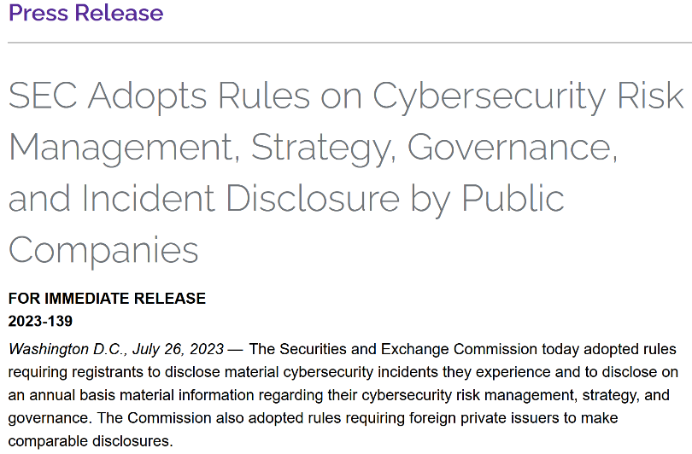
Cybersecurity/MFA Market Opportunity
Cyber-Insurance mandates
Federal Trade Commission (FTC Section 5 expansion)
Cybersecurity & Infrastructure Security Agency (CISA) Dec 2023 guidance to manufacturers to eliminate use of default passwords (which are easy to exploit)
AWS mandates MFA for most privileged users by mid 2024
Dec. 2023 IT-ISAC (Info Sharing & Analysis Ctr.) whitepaper called on SaaS and & cloud companies to embrace secure by default Principles (elevate security);
SEC cybersecurity disclosure rules effective Dec. 2023.

Slide 6
BIO-key Use Cases
Compliance & Insurance
Reducing Costs
HIPAA, PCI, NYDFS & other compliance requires added security & privacy controls.
Cyber insurance requires enhanced controls, especially MFA.
BIO-key enables regulatory & cyber insurance compliance.
Improving Usability
Kathy Pinto | VP of IT
Orange Bank & Trust
"BIO-key provides both biometric authentication and a proven suite of IAM solutions that provide greater security, flexibility, and value over approaches offered by other vendors.”
Enterprises have too many IAM solutions to manage with limited IT resources/ cyber-expertise.
Top brands are too expensive for SMEs.
BIO-key streamlines solutions, reducing vendor & IT team costs.
Reducing Cyber Risk
Users have too many passwords to remember
IT support flooded with password reset calls.
Each password reset call costs $70.
Prevent cyberattacks, including ransomware.
300% increase in cybercrimes in the USA since the start of the pandemic.
Notes:
TIP: They want to hear how similar people and personas have shared similar challenges and experiences that they can resonate with.
Are you concerned about cyberattacks and knowing who is accessing your data and applications? Are you trying to make sure that employees, customers, and suppliers can get to resources they need without being frustrated or blocked by security controls and passwords? Do you have limited IT resources to manage cybersecurity and protect your organization? You are not alone.
Most IT teams have limited resources to deal with a long list of cybersecurity threats, demands from the business for new technology, and frustrated users who are fed up with passwords getting in the way. BIO-key can provide the security you need, improve the user experience, and be a quick win for the IT team.
10 Questions to Ask:
Reduce Risk:
Do you know which applications and data are being accessed and by who?
Are your users practicing poor password habits (e.g., sharing credentials, writing them down, etc.)?
Are you concerned with or experienced cyberattacks such as ransomware & phishing attempts?
How are you securing access to your most critical applications & data?
Improve Usability:
How many passwords do your users have to remember?
Do you initiate forced password resets? How frequently?
What happens when a user forgets their password – do they call the help desk?
Have you considered going “passwordless”?
Reduce Costs:
What IT resources do you have dedicated to managing cybersecurity?
Compliance & Insurance:
Do you need to implement multi-factor authentication to meet compliance or cyber insurance requirements?

Slide 7
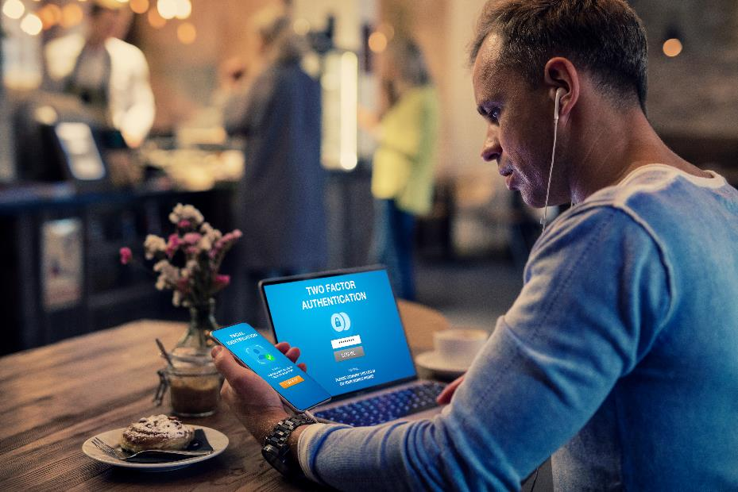
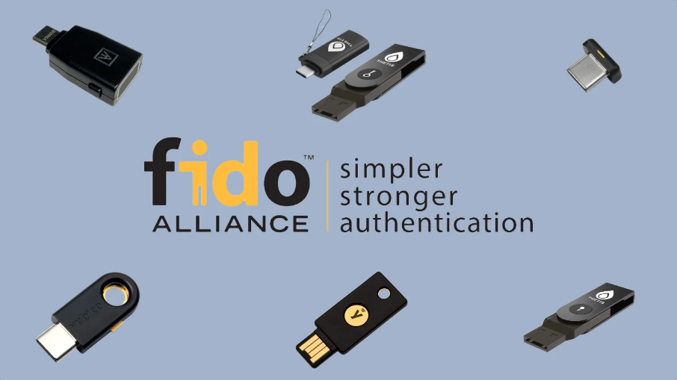
Mainstream MFA solutions offer only “Device Assisted Authentication”
Phone Apps
User tokens
OR

Slide 8
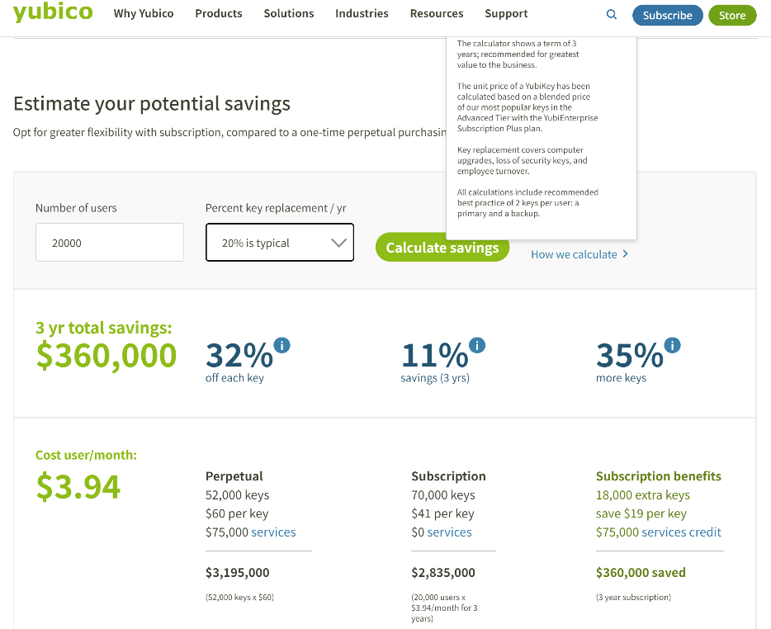
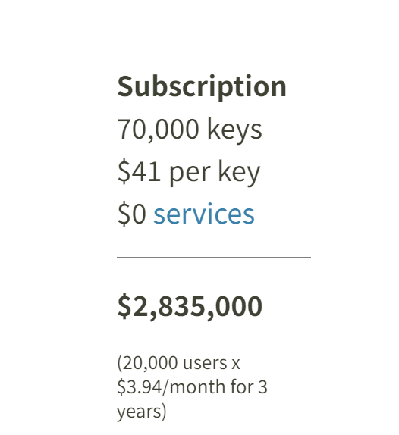
Hardware Token Deployment Costs
20K users = $2.8M every three years

Slide 9
Outline
The Future is:
IBB as an alternative – phone-less, token-less, passwordless
Notes:
We've been solving this for years – decades – without breach

Slide 10
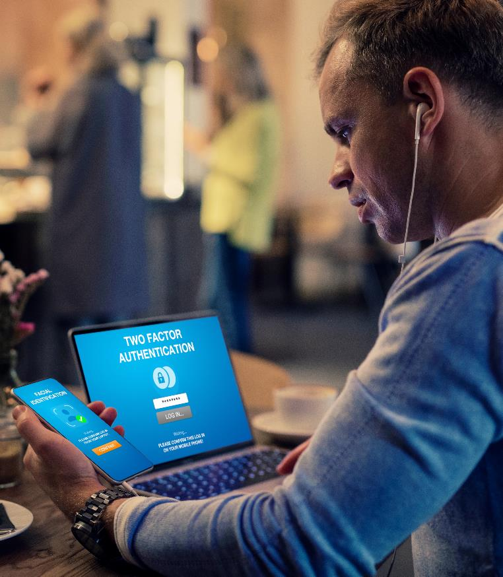
Phone Apps Work for Desk Worker Employees, but…
Employees often must leave phones in a locker
Clean Desktop (Call Center)
Data Security/Privacy
No Distractions
Safety (Manufacturing, Shop Floor, Healthcare)
Several states & EU require compensation for work-related personal phone use
California Labor Code § 2802(a): employer shall indemnify employee for all necessary expenditures/losses incurred in direct consequence of discharge of duties..."
Unpaid compensation can lead to costly class action claims.

Slide 11
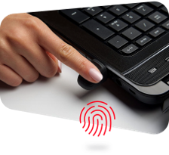
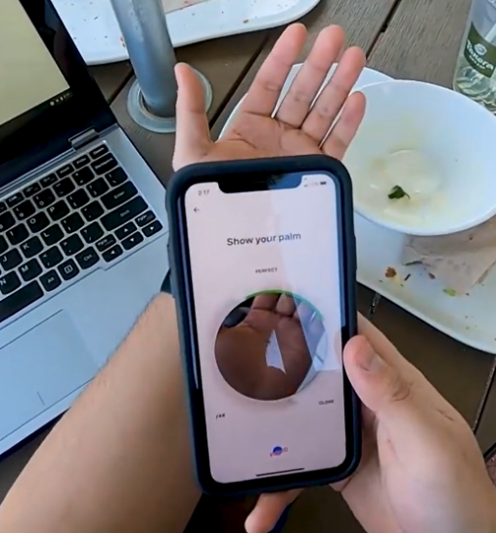
BIO-key’s Unique Differentiator: Phoneless and Tokenless Biometric Authentication
Identity Bound Biometrics creates a centrally managed unique biometric identity that can be used to verify users anywhere, based on who they are, not what they have to carry or know and could share.
Centrally secured, privacy law compliant biometrics
Patented, high security data and integrity protection
Captured using USB fingerprint scanners or via MobileAuth app.

Slide 12
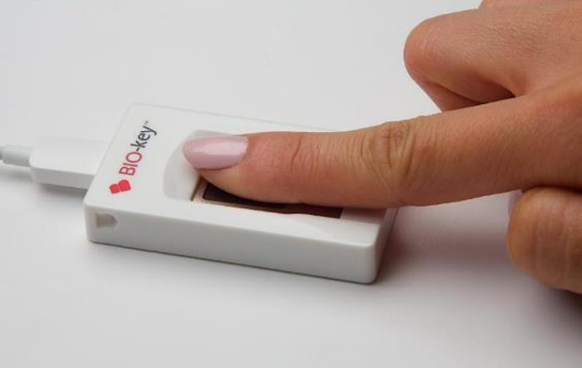
New Product: Passkey:YOU Replaces Phones and Hardware Tokens for Restricted Environments with a Touch of a Finger
Huge savings versus per-user tokens
Uses BIO-key Biometric authentication as a drop-in replacement for FIDO2 hardware tokens when signing into shared workstations
Manufacturing
Repair Centers
Call centers
Retail
Healthcare
Sensitive Compartmented Information Facilities (SCIFs)
Compatible out of the box with existing identity infrastructure, e.g. Microsoft Entra, Okta, Ping and others
FIDO-Certified
Simplified and more secure account recovery when other authenticators are lost

Slide 13
BIO-key Value Proposition
Complete MFA offering with Phoneless & Tokenless authentication
Leveraging patented biometric capabilities widely deployed/proven in the highest-security settings in the world.
Growing Base of Major Enterprise Deployments
Global Defense Ministries, Banks, Hospitals/Healthcare, Retail, Call Centers
Ideal for manufacturing, construction, healthcare
In Proof of Concept with industry leaders in:
Residential construction
Retail Grocery
Call centers
Automotive OEM

Slide 14
Gartner is Informing Enterprises about the Value of BIO-key’s Capabilities
“User authentication is fundamental to identity-first security and an imperative for security and risk management leaders responsible for identity and access management (IAM leaders). “
“Unlike the two other types of authentication credentials (knowledge and possession), biometric traits are inherent to a person, thus providing a uniquely human basis for authentication.”
“Biometric authentication potentially frees the person from having to remember a password or carry a token, enhancing user experience (UX). Biometric traits also provide a robust basis for binding other authentication credentials to a living person via identity verification (IDV).”
Already seeing referred leads
Source: Gartner Innovation Insight for Biometric Authentication, 20 December 2023

Slide 15
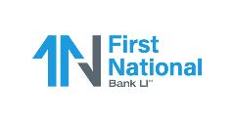
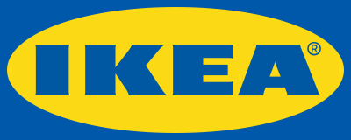
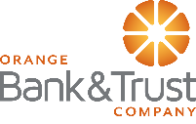
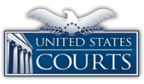
Customers Relying on BIO-key

Slide 16
BIO-key Go to Market Strategy
Paths to Market
Expanding Channel Alliance Partner Program with Global Reach
Deals from $25k to $500k+
Direct Sales Targeted at Major Customers
Deals from $300k to $5M+
Use Cases
Users of Competing MFA Solutions:
MFA with add-ins such as “FIDO Passkey” to eliminate the need for tokens and phones
Eliminate Costs of phone use reimbursement & tokens
Extend Security to heretofore exempted users
New Prospects
Value priced MFA solution with addition of phoneless, token-less authentication options
Lower Subscription Cost plus eliminate phone reimbursement & token costs.

Slide 17
Expanding IP Portfolio
18 U.S. Patents including three recently issued
ENABLING NEXT-GENERATION CONTINUOUS BIOMETRIC USER AUTHENTICATION (Patent 10,984,085)
Patent protects method of enabling next-generation continuous and passive biometric user experiences with its process for enrollment and continuous authentication.
BIO-key’s intelligent data pre-processing and transformation algorithms sort through varying samples of biometric data, making reliable and accurate connections between samples of different sizes, resolution qualities and points of view – supporting continuous authentication of a user’s identity during ongoing activity. Methods particularly valuable for mobile devices with in-screen fingerprint sensors, cameras and microphones providing a continuous stream of partial biometric samples over time.
UTILIZATION of BIOMETRIC DATA (Patent 10,002,244)
Enables BIO-key to capitalize on the transition of mobile devices to in-screen, “under glass” biometric sensors – though patent is broad enough to apply to sensors anywhere on a device.
Patent leverages continuous stream of partial fingerprint, facial or other biometric captures that occur as user interacts with a device. Technique enables a continuous, passive authentication for greater security with little workflow impact.
ADAPTIVE SHORT LISTS & ACCELERATION of BIOMETRIC DATABASE SEARCH (Patent 10,025,831)
Indexing method for quickly & iteratively searching a large-scale database of biometric records.
Large-scale Automated Fingerprint ID Systems like that used by the FBI were once the exclusive province of big-budget agencies and enterprises. BIO-key’s method uses 1 or more scans of a database with varying parameters, narrowing the field of candidates with each pass. Provides unique advantage in delivering cost-effective, 1-to-many ID solutions that avoid costly, resource-intensive brute force scans.
BIO-key is well positioned for inevitable growth in use of Identity Bound Biometrics

Slide 18
Growth Strategies
Launch New Products, Enhance Solutions
Introduce new biometric modalities
Add functionality upgrades to WEB-key
Add Provisioning and Governance modules to PortalGuard platform
Expand Global Reach
Introduce Integrated Platform to International Partners & End Users
Targeted Grow in International Partner Base to expand reach in select regions and verticals
Cross-Selling / Up-Selling
Significant opportunity offer biometric solutions to PortalGuard & Swivel Secure customers
Deploy PortalGuard IDaaS to legacy BIO-key/Swivel Secure customers
Grow Business Development Effort
Find technology partners that complement integrated platform and expand opportunity base
Offer biometric solutions to existing IAM vendors to broaden opportunities and enhance biometric brand
Partner with other biometric modalities for integrations
Expand Sales and Partner Network
Grow Channel Alliance Program (CAP) with new IAM partners (Resellers, MSP’s, Integrators)
Expand Master Agent program for SaaS sales
Invest in Marketing Programs to drive broader awareness of Integrated Platform

Slide 19
Leadership Team
Michael W. DePasquale – Chairman & CEO 25+ years in executive management, sales and marketing.
Cecilia Welch – CFO 20+ years of tech operational and financial management experience.
Mark Cochran – President PortalGuard 20+ years of experience in Security and IAM markets.
Jim Sullivan – CLO, SVP Strategy 25+ years enterprise sales in identity and access management, including with key customers AT&T, Capitec Bank, World Bank, NCR & Omnicell.
Alex Rocha – CEO of Swivel Secure Europe Former sole stockholder of SSE with 20+ years sales & management experience in EMEA mkt.
Kelvin Wong – MD HK Subsidiary, co-founder of World-Wide Touch Technology; 15+ years in manufacturing and marketing management, including biometrics & payments.
Akintunde Carlton JeJe – MD Africa respected, experienced executive with extensive knowledge & relationships in Nigerian & African markets.
Mira LaCous – CTO 30+ years solution development and product management.
Galen Rodgers – VP Sales & Channel 20+ years in channel program development, marketing, value selling, management, cybersecurity, process automation, coaching & team building – most recently with Ping Identity Corporation.

Slide 20
Investment Consideration - Recap
30% revenue growth Q3 and year-to-date
Growth driven by channel partners and inside sales team focused on large opportunities
Q3 operating loss trimmed to $750k from $2.4M; 9M decreased to $2.3M from $5.0M
$7M in Annual Recurring Revenue and growing; up from $3M in 2020.
~$4M Market Cap
Growing global requirement for more secure identity & access management in all verticals fueled by:
Work from anywhere
Demand for password-less and phone-less authentication
Enterprises pressed from all sides to implement enhanced cybersecurity/MFA
Deep biometric leadership + broad, flexible array of authentication factors
Continued Innovation from veteran engineering team meeting evolving needs
Compelling Valuation
BKYI is trading ~ 0.5x Price/TTM Revenue vs. median 7x for identity comps (OKTA, CYBR CHKP)

Slide 21
Thank You Company Contact: Michael DePasquale Chairman & CEO michael.depasquale@bio-key.com 732.359.1100 Investor & Media Contacts: William Jones; David Collins Catalyst IR bkyi@catalyst-ir.com 212.924.9800

